Slide 1
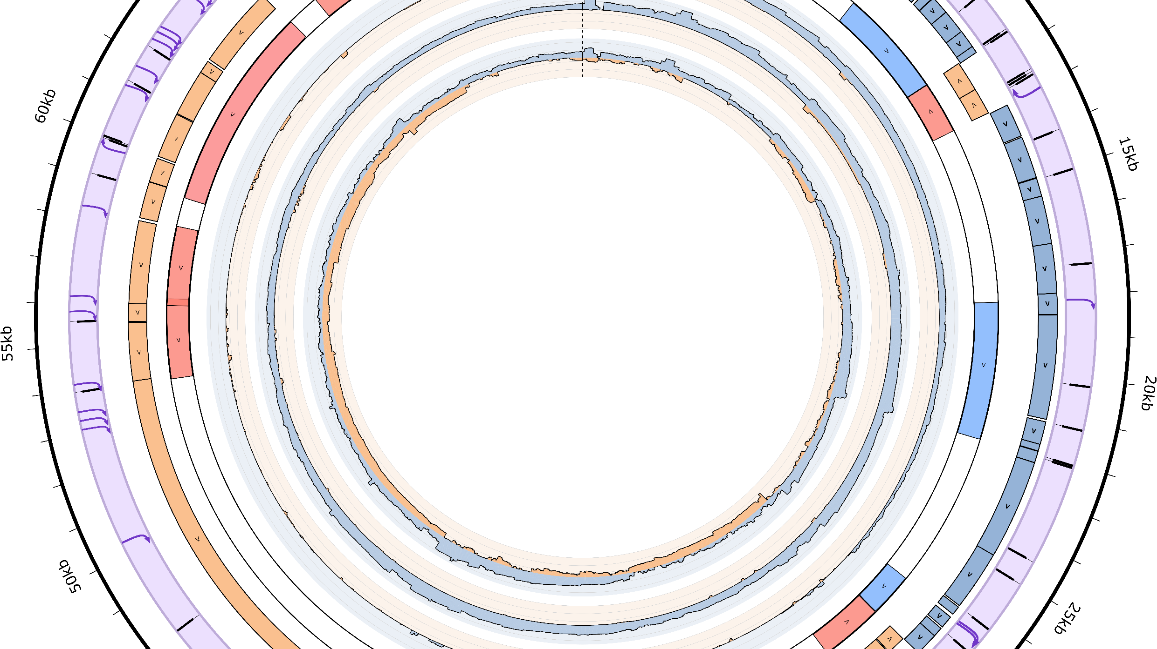


Mapping the transcriptional architecture of bacterial viruses with ONT-cappable-seq
Maarten Boon
Laboratory of Gene Technology, KU Leuven

Slide 2
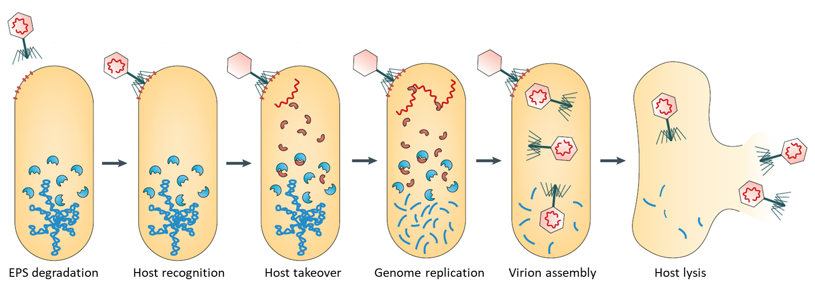
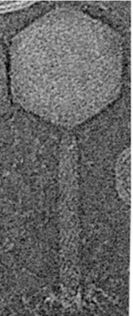

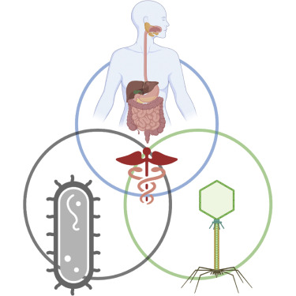
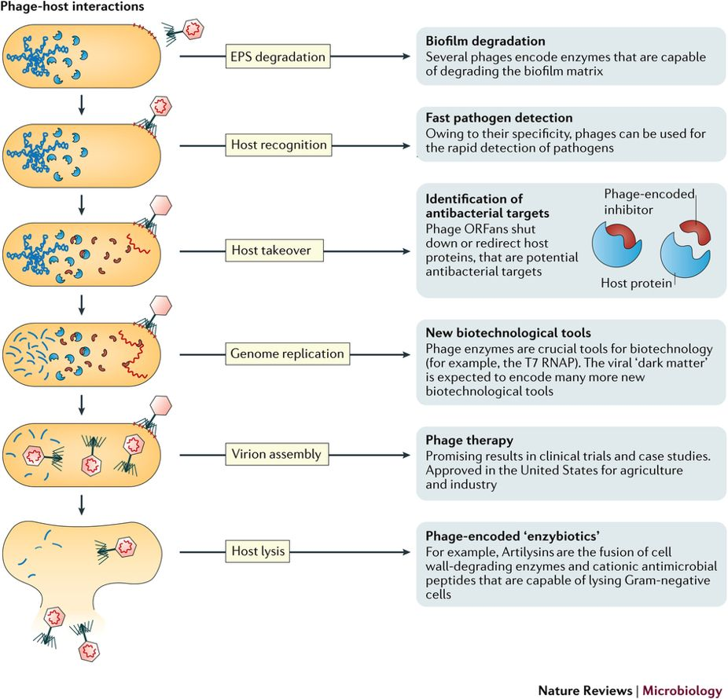
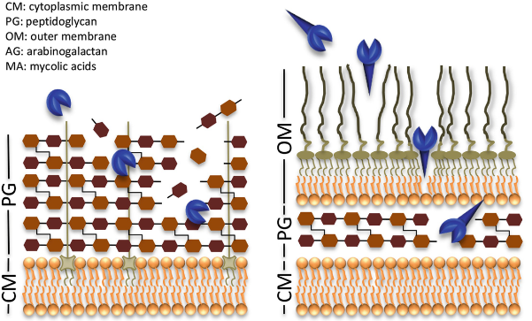



Bacteriophages, efficient eradicators of bacteria
Phage therapy
Phage-inspired molecules & Synbio tools
Phage enzyme antimicrobials

Slide 3
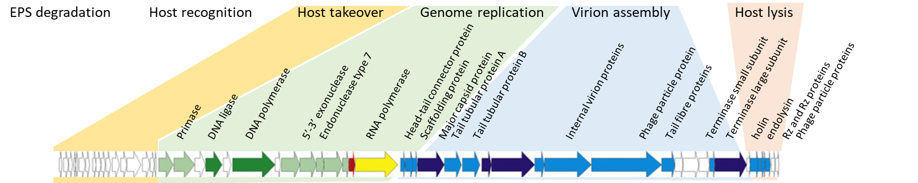
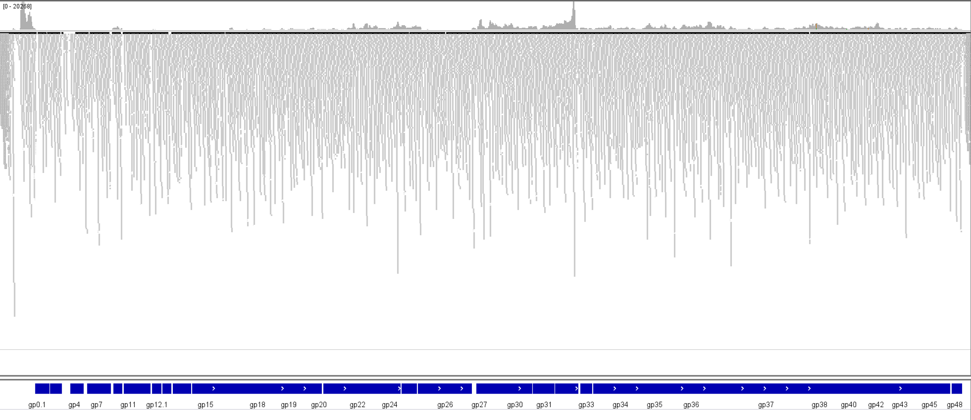

The challenge of decoding phage genomes
Strict organisation and regulation
Densely coded, limited intergenic regions
Gene content largely unknown
RNA-seq
End-to-end nucleotide composition of individual transcripts is lost
Key transcriptional features, such as TSS, TTS and operon structures are often overlooked
Different approach required for understanding HOW transcription is organised

Slide 4
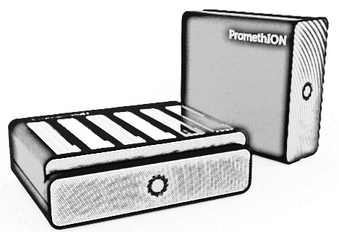
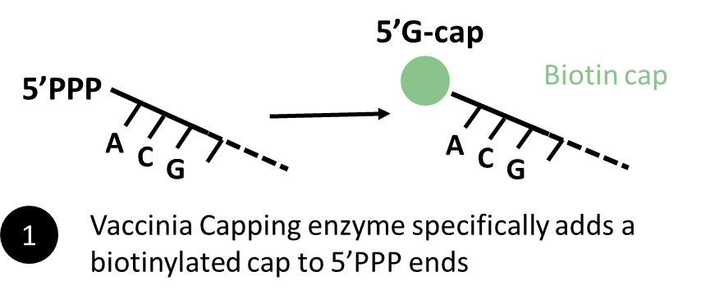
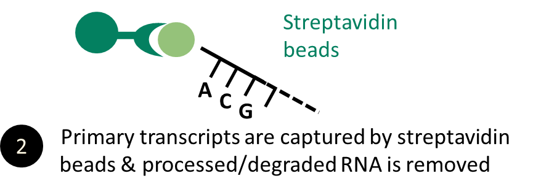

Phage transcriptomics with ONT-cappable-seq
T
5’PPP-
5’P-
5’P-
5’P-
Primary transcripts (1-5%)
Processed/degraded transcripts (>90%)
3
Nanopore sequencing
Cappable-seq: Etwiller et al. BMC genomics (2016)

Slide 5
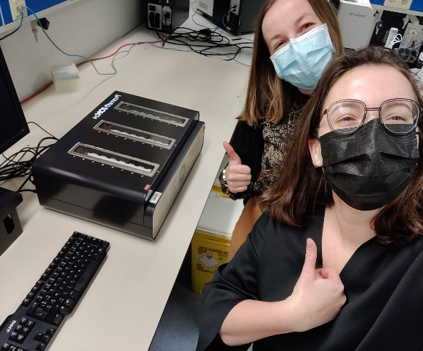

ONT-cappable-seq workflow

Slide 6
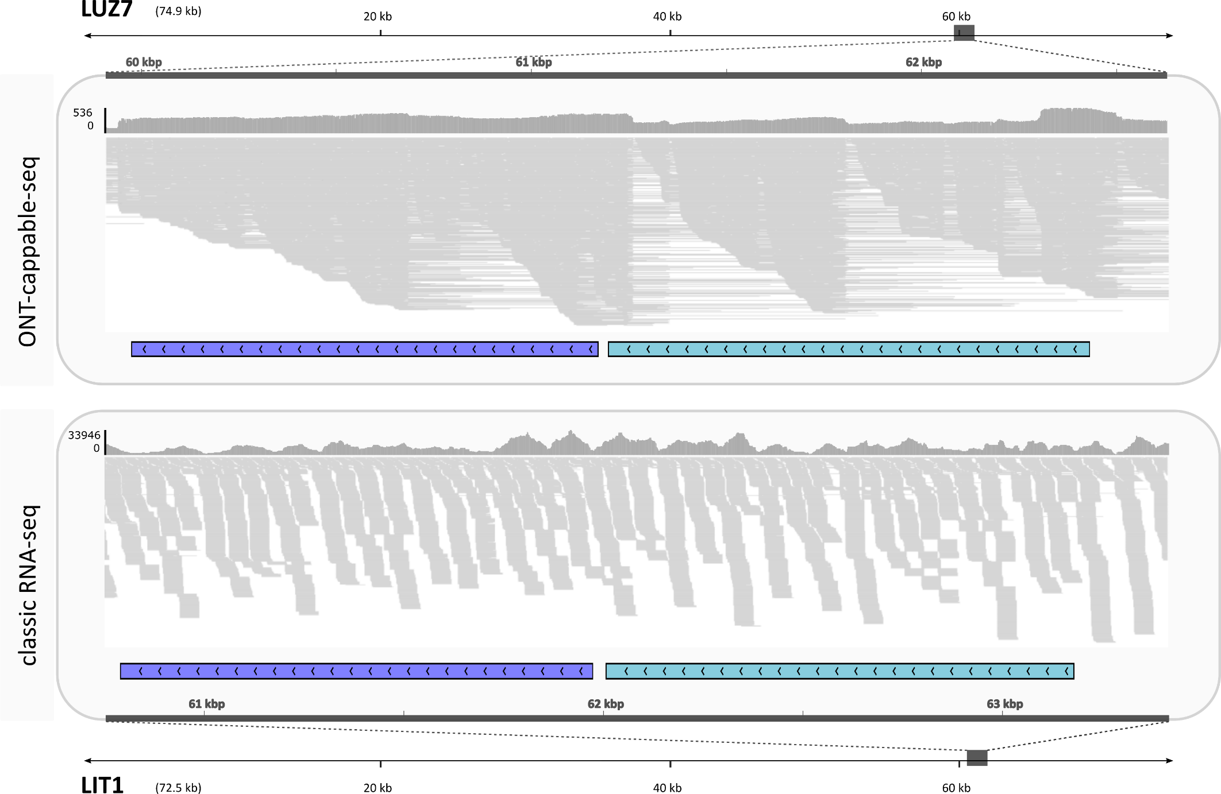
Unraveling previously obscured transcription features

Slide 7
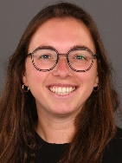
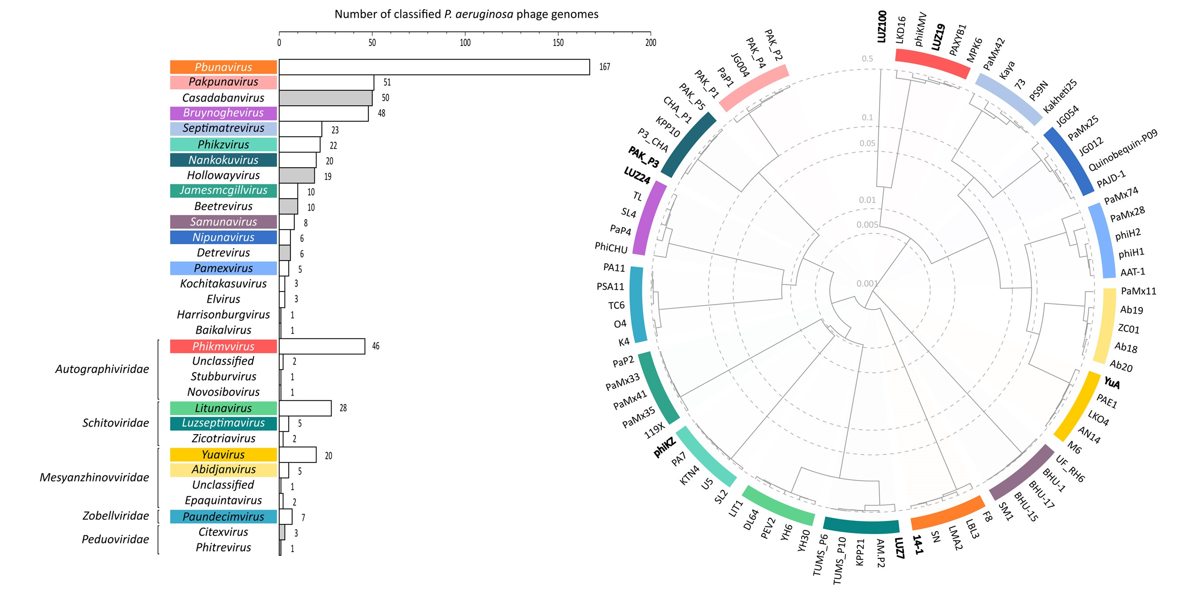
Pseudomonas aeruginosa phages as testbed
Selected 8 Pseudomonas phages representing different taxonomic clades
Leena Putzeys
Putzeys et al. microLife (2024)

Slide 8
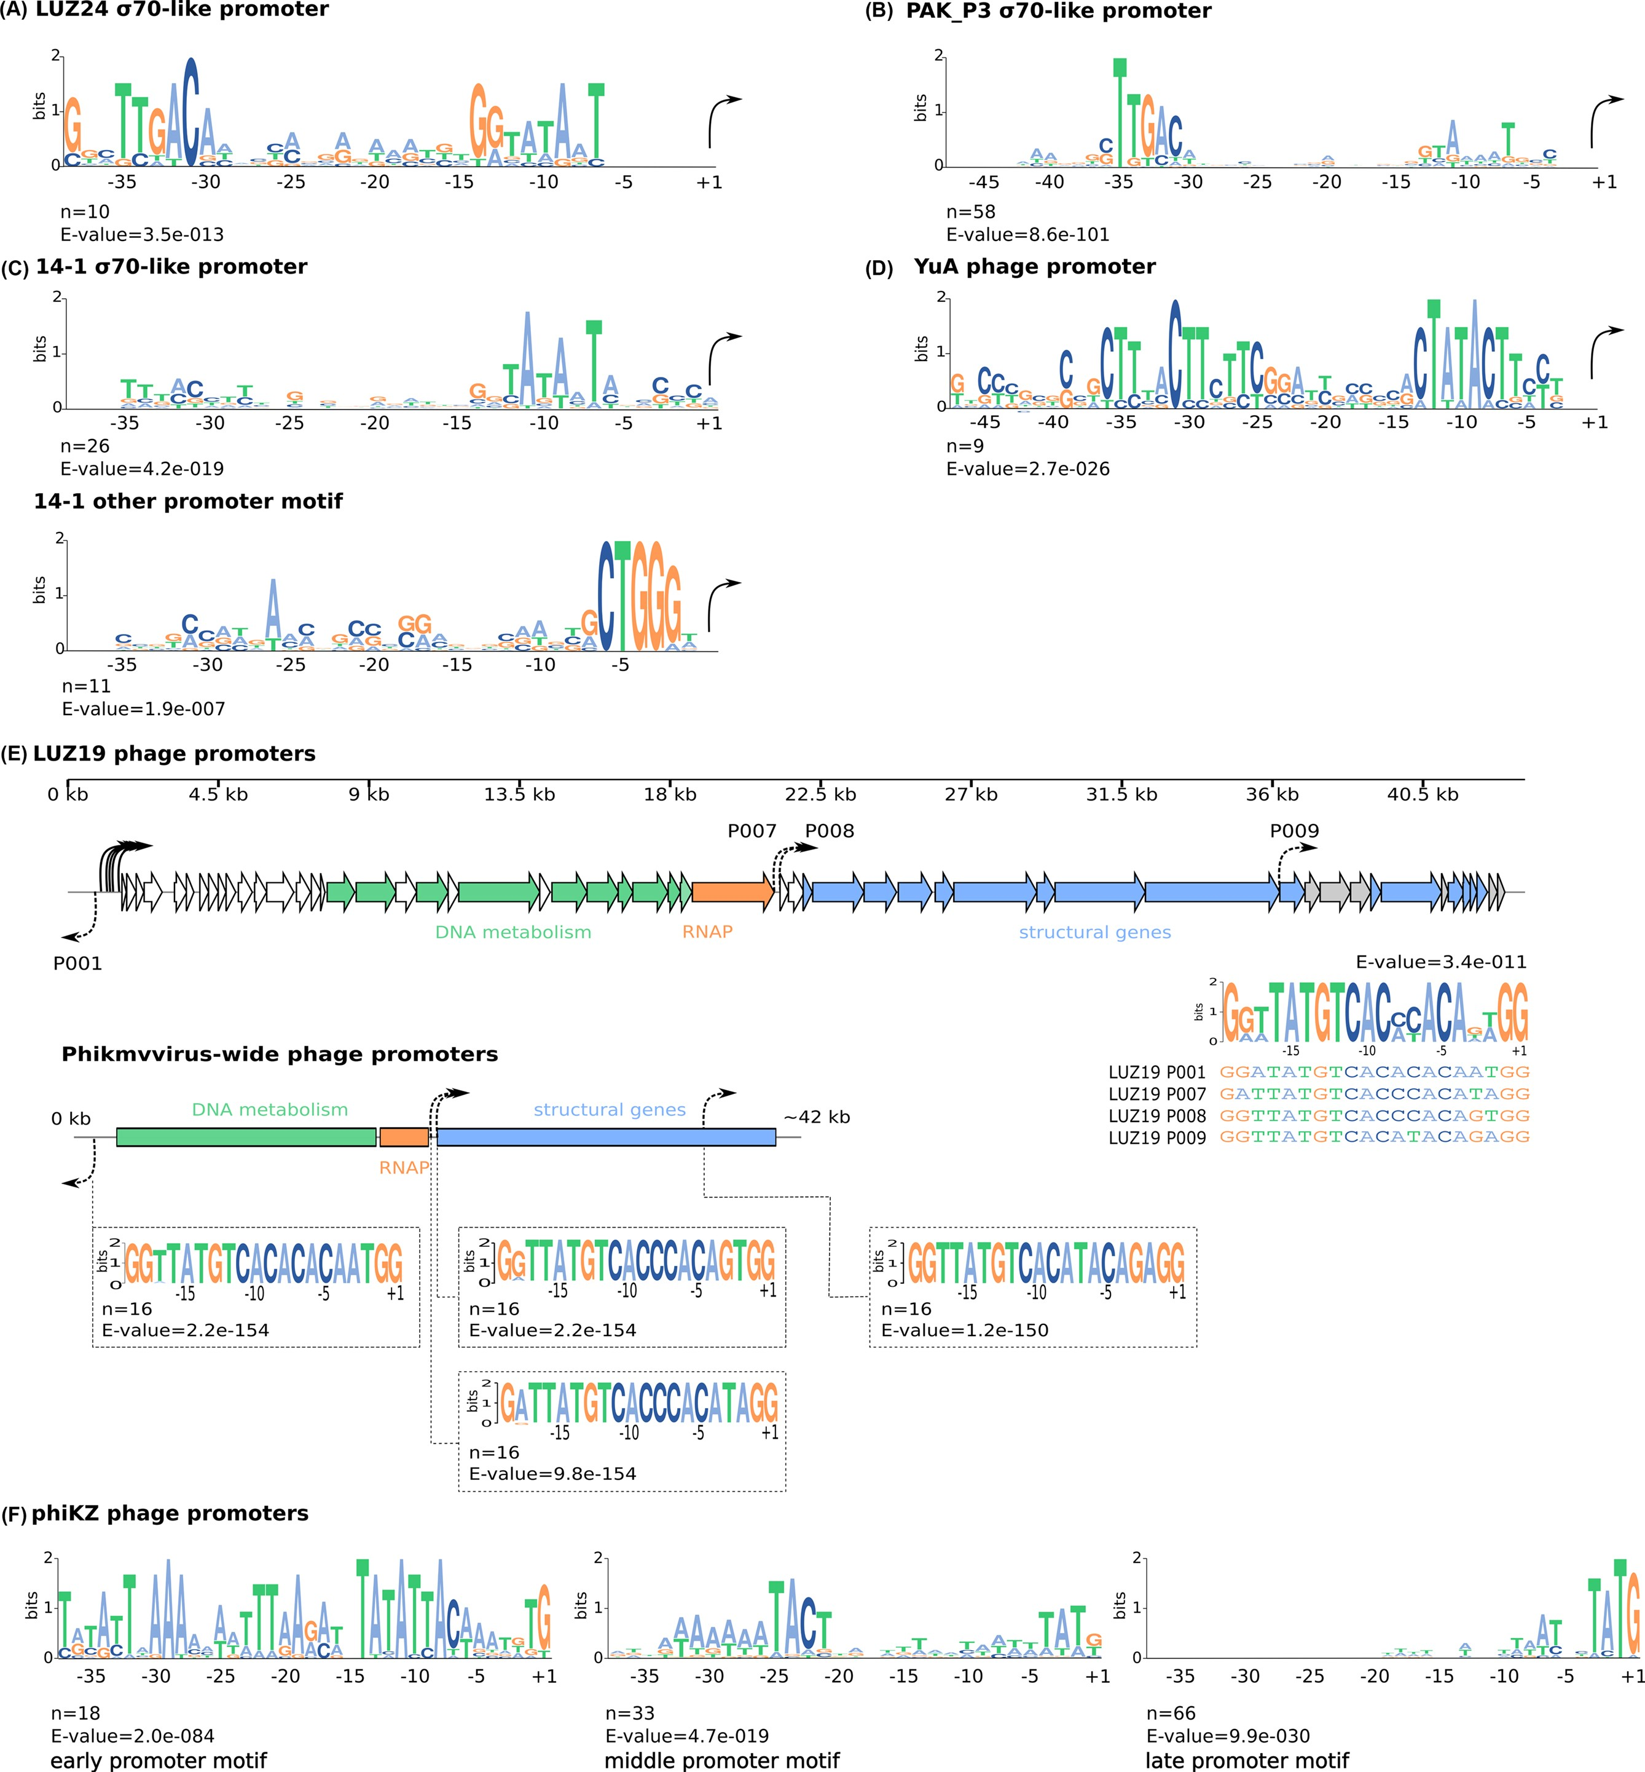
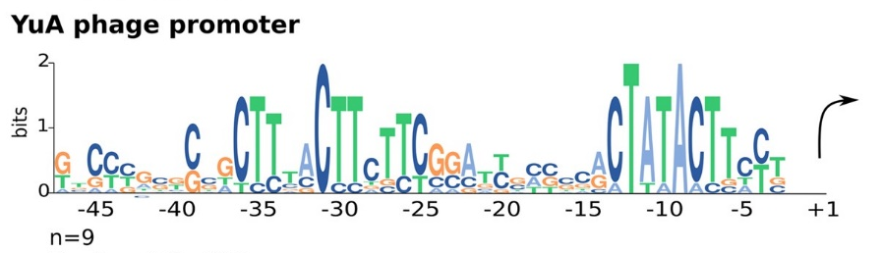


Diverse promoters for diverse transcription schemes
Identified >320 TSS and numerous phage specific promoter motifs
σ70-like promoters
Others (using host RNAP)
Orthogonal promoters
LUZ24 σ70-like promoter
YuA promoter
PhiKZ promoters
Early
14-1 σ70-like promoter
14-1 other promoter motif
Middle
PAK_P3 σ70-like promoter
Late
Putzeys et al. microLife (2024)

Slide 9
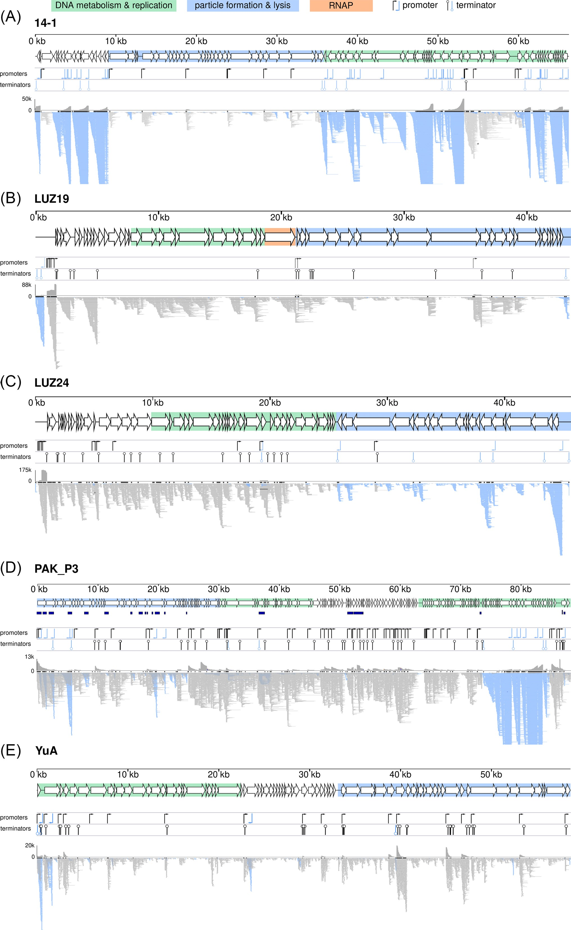
From insights for a single phage to clade-wide trends
Putzeys et al. microLife (2024)

Slide 10
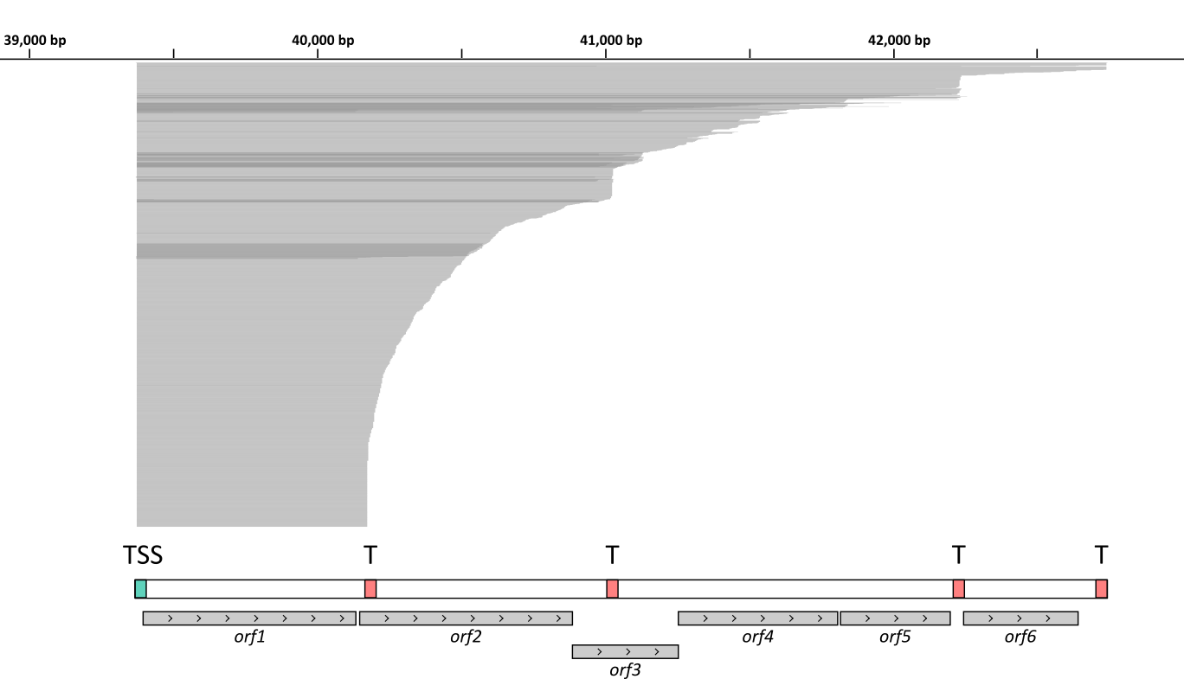
Terminators tweak transcript abundance
Identified 351 TTS across 8 phage genomes
>50% genes reside in at least 2 transcription units
Functional relation within TUs/operons could aid gene annotation
Putzeys et al. CSBJ (2022)

Slide 11
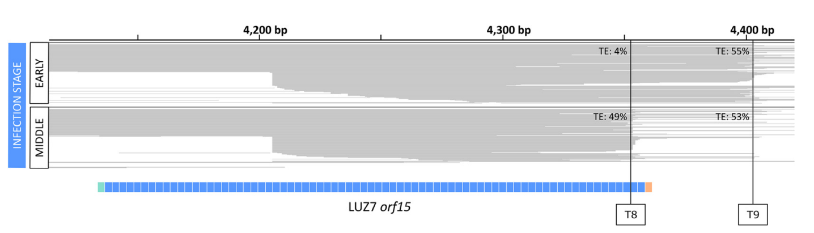
Infection stage-dependet transcription termination
Putzeys et al. CSBJ (2022)

Slide 12
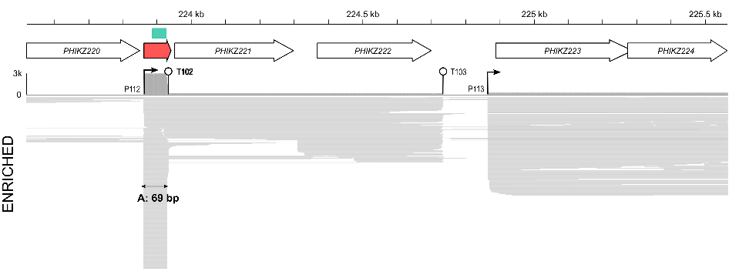
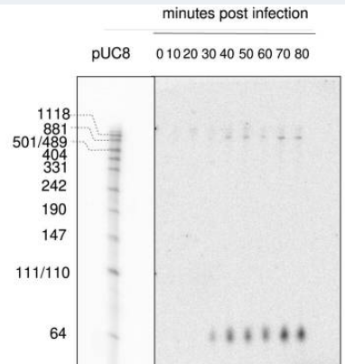
Non-coding RNAs are widespread among phages
31 ncRNAs and putative sRNAs detected across our phage set
1-17 ncRNAs/phage
ncRNA
Putzeys et al. microLife (2024)

Slide 13
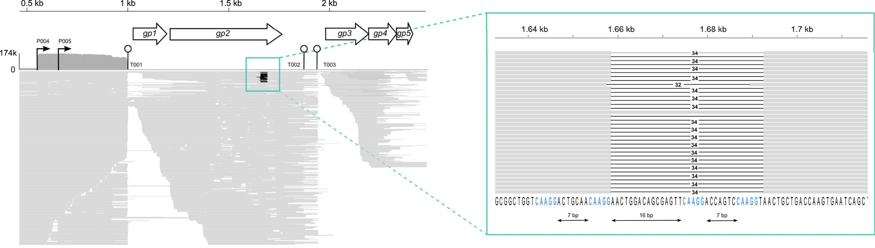
Accurate identification and delineation of introns
LUZ24
Accurate delineation of new splice sites (e.g. in LUZ24 gp2 with regular interspaced CAAGA motif)
→ Splice sites such as those in DNA Polymerases are likely regulated in time
Putzeys et al. microLife (2024)

Slide 14
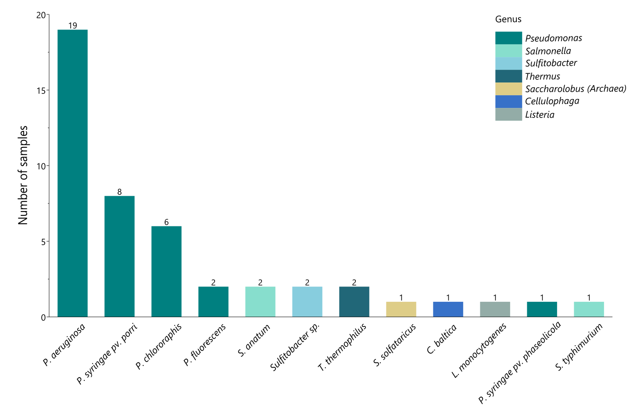
ONT-cappable-seq is broadly applicable across microbial viruses
Total phages analyzed: 29
- A broad range of different taxa
Phage genome size range 15.5 kb – 316.7 kb
Virulent and temperate phages
Pooled vs. temporal sequencing approach
ONT-cappable-seq provides new insights into the RNA biology of phages with high-throughput identification of regulatory elements.

Slide 15
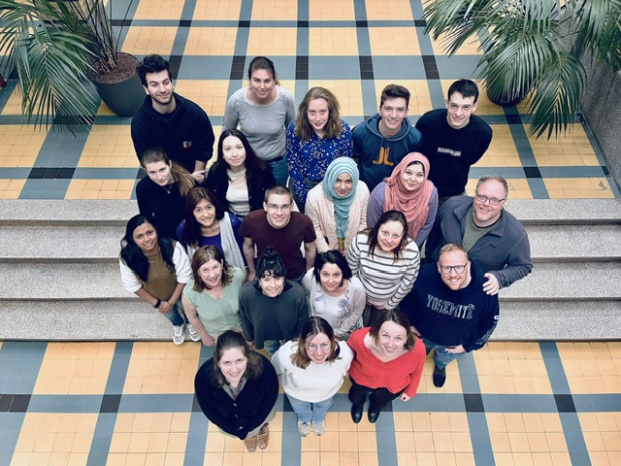
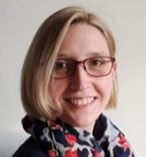
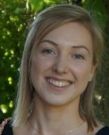



Acknowledgments
Laboratory of Gene Technology
Prof. Rob Lavigne
Dr. Leena Putzeys
Dr. Eveline-Marie Lammens
Jorien Poppeliers
Laura Wicke
Collaborators
Prof. Jörg Vogel
Funding
Special research fund iBOF

Slide 16
Transcriptomics – Analysis

